Slide 1
WAPDropper Case Study
Story of Telecom Billing exploitation

Slide 2

Presenter
Ravi Rajput
Principal Architect Information Security– NeoTech Global PVT LTD
Cybersecurity Expert | Creator of AutoHackOS | DEFCON Village Organizer
Core Expertise:
Telecom and Automotive Cybersecurity
Vulnerability Research (Windows, Linux, ARM)
Reverse Engineering & Advanced Penetration Testing.
Contributions:
Developed AutoHackOS, a globally adopted automotive pentesting OS, launched at Black Hat
Millions of downloads by researchers and OEM testers worldwide
Recognized for tool innovation in vehicle telematics and firmware analysis.
Community Roles:
Core Team member at DEFCON Telecom Village
Speaking Engagements: Presented at DEFCON, BLACKHAT, HITB, Nullcon, HITCON and several Bsides Conferences.

Slide 3
Agenda
Background
Threat Landscape
WAPDropper Technical breakdown
Infection Chain
Technical Anatomy
Obfuscation
Telecom Billing Manipulation
Ecosystem Risk
Detection Strategies

Slide 4
“Did you check your phone bill? Paying extra?”

Slide 5
What is WAP Billing?
Wireless Application Protocol (WAP) billing, also known as Direct Carrier Billing (DCB), is a mobile payment method that allows users to purchase digital content or services and have the cost directly charged to their prepaid balance or added to their postpaid telecom bill.

Slide 6
How it works?
A user browsing a website or app clicks on an offer
The user is redirected to a mobile-friendly billing page hosted by the telecom provider or a third-party content aggregator
The user confirms the subscription or purchase (often with one tap)
The charge is instantly processed via the mobile carrier’s billing system.

Slide 7
Billing Threat Model
Telecom billing systems expose public-facing APIs and web portals that manage subscription workflows, payments, and content delivery. These interfaces rely on a mix of session cookies, subscriber identity (MSISDN), and browser signals to process transactions.
Once a billing session is initiated—often through a mobile browser or WebView—the user’s SIM card identity is implicitly trusted, and the transaction proceeds with minimal verification, usually a single tap or redirect.

Slide 8
Vulnerabilities
Billing APIs and Web Interfaces: These endpoints often lack client-side validation or rate limiting. They expect that requests originate from human-driven browser interactions.
Session ID Misuse: Session identifiers tied to a user session are vulnerable to abuse if malware can simulate traffic from the same environment (e.g., via injected WebViews or spoofed headers).
WebView Abuse: Malicious apps use Android WebView to render billing pages invisibly (1x1 pixels), load subscription URLs, and trigger transactions without user visibility or interaction.

Slide 9
The Silent Evolution
Phase 1:
The Era of Premium SMS TrojansIn the early 2010s, Android malware focused heavily on sending SMS messages to premium-rate numbers—owned or monetized by attackers. Trojans like Joker, FakeInst, and Hummer would silently send SMS in the background to shortcodes that incurred charges per message.
These attacks were visible on billing statements.
Users received confirmation SMS messages.
Detection was easier via spam filters, AV signatures, and SMS monitoring apps.

Slide 10
The Silent Evolution
Phase 2:
As defenses improved, attackers began obfuscating code, encrypting payloads, and bypassing Google Play protections by hosting APKs on third-party stores or using time-bomb logic.
Droppers became modular and used reflective loading.
Social engineering became more polished (e.g., fake utility apps).

Slide 11
The Silent Evolution
Phase 3:
With telcos embracing Direct Carrier Billing (DCB) via web interfaces, attackers pivoted to a stealthier model: WAP-based fraud. Instead of using SMS, malware now:
Opens a hidden WebView in the background
Loads a legitimate telecom subscription page
Bypasses CAPTCHAs using ML image solvers
Simulates a user click, silently triggering the billing process

Slide 12
Why Harder to detect?
No SMS traffic involved
No app permissions required
Billing handled by legitimate telecom infrastructure
Transactions look indistinguishable from genuine user behavior

Slide 13
WAPDropper Case Study
WAPDropper is an Android malware designed to exploit telecom billing APIs and Direct Carrier Billing (DCB) infrastructure. Its goal is to silently subscribe users to premium services through legitimate telecom providers, without their knowledge or interaction.
Two staged malware: 1. Dropper Module
2. Premium Dialer Module
This is the case study of Research and findings of Checkpoint : https://research.checkpoint.com/2020/enter-wapdropper-subscribe-users-to-premium-services-by-telecom-companies/

Slide 14
WAPDropper Case Study
Dropper Module
Initiates the infection by collecting device fingerprints (IMEI, subscriber ID, app list, RAM, screen status, etc.)
Communicates with a central Command & Control (C2) server to fetch the second-stage payload
Decrypts and executes .dex modules dynamically and removes them post-execution to avoid detection

Slide 15
WAPDropper Case Study
2. Premium Dialer Module
Triggers the actual fraud
Loads telecom billing pages in hidden WebViews
Injects malicious JavaScript and removes X-Requested-With headers to bypass CSRF protections
Solves CAPTCHA challenges using machine learning-based image recognition services, simulating clicks and form submissions

Slide 16
Infection Chain
Stage 1 – Initial Infection via 3rd Party App Stores:
The attack begins with the victim installing a seemingly harmless Android application from a non-official app store. These apps contain the dropper module, which executes automatically post-installation.
Stage 2 – Device Profiling and Evasion Checks:
Upon execution, the malware:
Hides its app icon to avoid detection
Gathers detailed device information:
IMEI, IMSI, Subscriber ID, MAC address
App list, foreground activity, available RAM
Screen status and overlay permissions
Checks if the device is behind a proxy or VPN to avoid running in sandboxed or analyst environments

Slide 17
Infection Chain
Stage 3 – Contacting Command & Control (C2) Server:
The dropper sends the device profile to a hardcoded C2 server (e.g., ks7br7.3q03on[.]com)
The C2 responds with a list of rotating C2 endpoints and a configuration JSON containing:
URLs to fetch payloads
Execution frequency
MD5 hashes for validation
Method/class names to invoke via reflection

Slide 18
Infection Chain
Stage 4 – Payload Decryption and Execution:
The dropper downloads .dex payloads, decrypts them into .jar files, and loads them into memory. The files are deleted post-loading to eliminate forensic traces.
Stage 5 – Execution of Premium Dialer Module:
Loads telecom billing pages in a 1x1 pixel hidden WebView
Bypasses CSRF protections by removing critical headers
Solves CAPTCHA challenges using image recognition APIs
Simulates user clicks and subscriptions silently

Slide 19
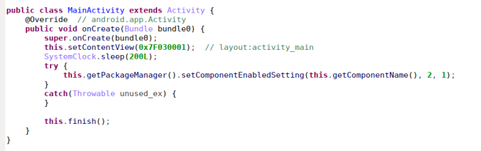
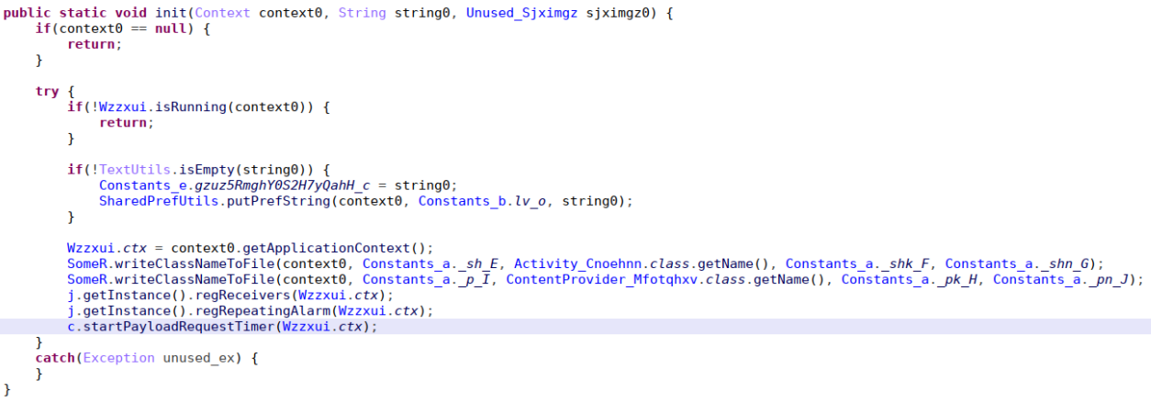
The Devil Code – Initial Execution
Hides icon
Dropper Initialization

Slide 20
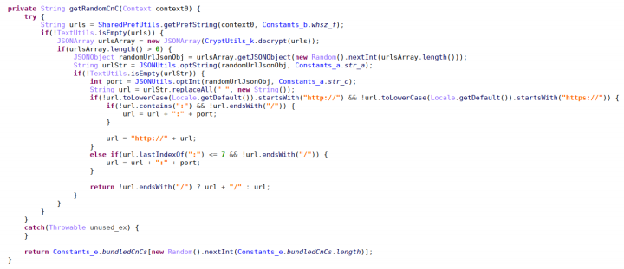
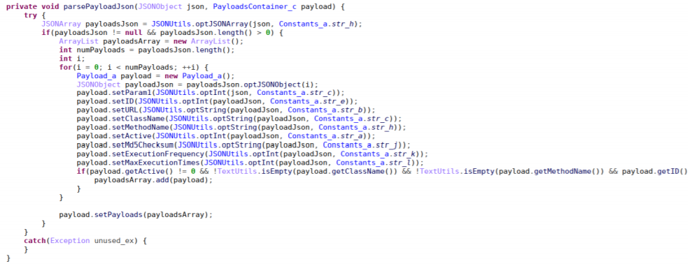
The Devil Code – Initial Execution
Picks C2
JSON Payload

Slide 21
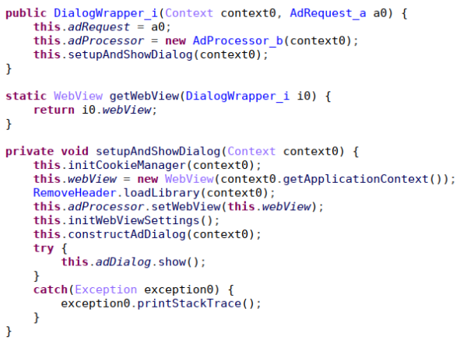
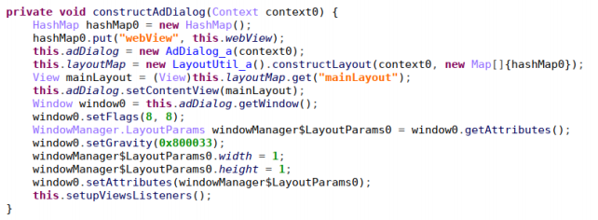
The Devil Code – WebView Exploitation
Malware constructs 1x1 pixel dialog Webview to subscribe the WAP service

Slide 22
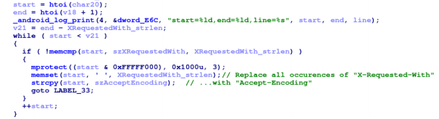
The Devil Code – WebView Exploitation
X-Requested-With header being replaced by Accept-Encoding by native library

Slide 23
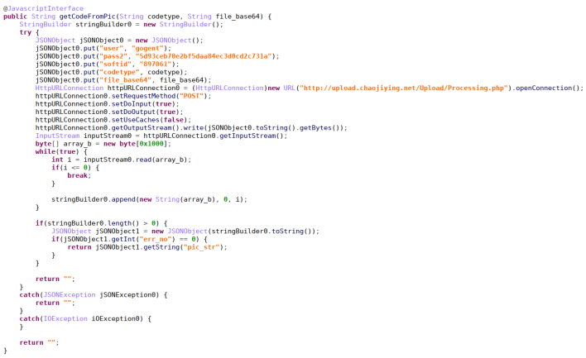
The Devil Code – CAPTCHA Bypass
Captcha Image is sent to Chinese company to bypass captcha using Machine Learning called Super Eagle

Slide 24
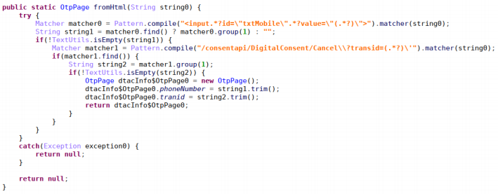
The Devil Code – Service Avail
Final Subscription mimicking user behavior for availing WAP service and charging money from User’s prepaid amount or postpaid bill

Slide 25
Mitigation Strategies
Behavioral Profiling of Subscription Requests:
Build logic to detect subscription bursts from same user-agent or IP
Enforce rate-limiting on billing API endpoints per MSISDN or device fingerprint
Flag sequences that complete the flow without multiple user clicks or dwell time
Telemetry Feedback Loops:
Use post-billing feedback signals (e.g., mass user unsubscribes within 24 hrs) to auto-flag fraudulent campaigns
Deploy user behaviour analytics (UBA) across carrier billing records to catch anomalies like one-tap subscriptions from non-human actors
Cross-Partner Audits:
Telecoms should regularly audit content provider partners and billing aggregators
Require stronger interaction verification from third-party billing portals

Slide 26
Thank You @infosecravi @frustratedresearcher

